Slide 1

Simulation of Laparoscopic Kidney Nephrectomy in Unity Generating Synthetic Data for Computer Vision Tracking
Author: Saivinay Manda
Student ID: S4845876
Course: Group Project
Date: 13/07/2024
Supervisor: Alessandro Carfi

Slide 2
Introduction
Laparoscopic Surgery Challenges
Problem Statement
Importance of Synthetic Data
Project Goals
Technological Innovations
Expected Outcomes

Slide 3
Problem Statement
Importance of accurate tracking in laparoscopic kidney surgery
Limitations of current methods
Aim to improve precision through a Unity-based simulation

Slide 4
Importance of Synthetic Data
Role of synthetic data in machine learning
Benefits of scalability, customizability, and lack of ethical/logistical constraints
Use in developing robust algorithms

Slide 5
Project Goals
Enhancing Surgical Precision
Reducing Complications
Technological Advancement

Slide 6
Technological Innovations
High-Resolution Anatomical Models
Dynamic Simulation Environment
Automated Data Annotation
Cinematic Visual Effects

Slide 7
Literature Review
Medical Imaging and Simulation
Synthetic Data Generation for Medical Purposes
Computer Vision Models in Laparoscopic Surgery
Leveraging Unity's Capabilities for Simulation and Data Generation

Slide 8
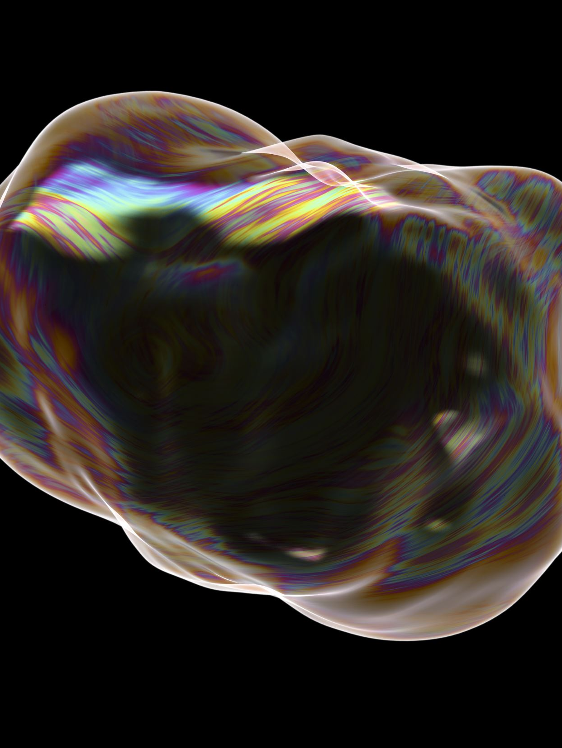
Methodology Overview
Simulation Setup: Describe how you created the Unity simulation using 3D models, textures, and cinematic packages.
Kidney Scenario: Explain the laparoscopic nephrectomy scenario and the dynamic environment you created.

Slide 9
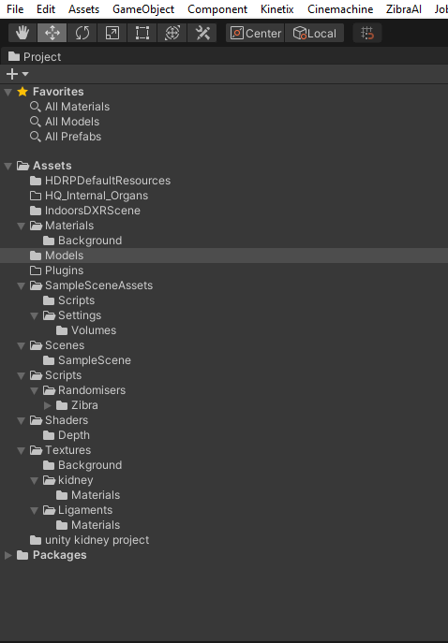
Unity Simulation Setup
Overview of project structure in Unity
Explanation of folder organization for efficient development

Slide 10
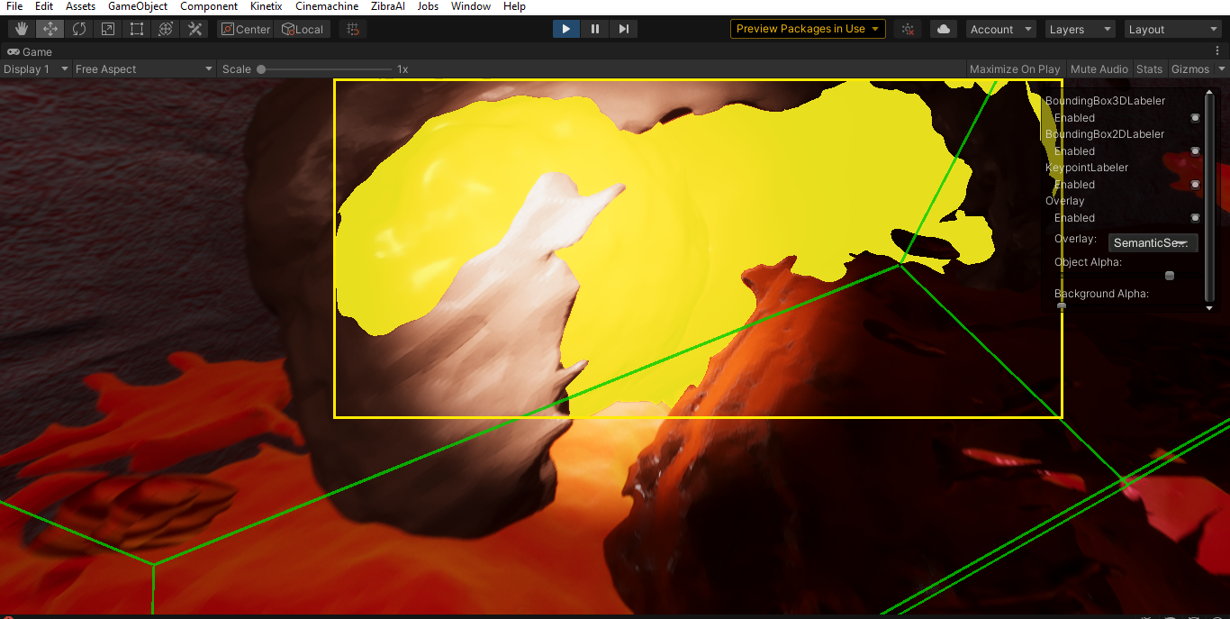
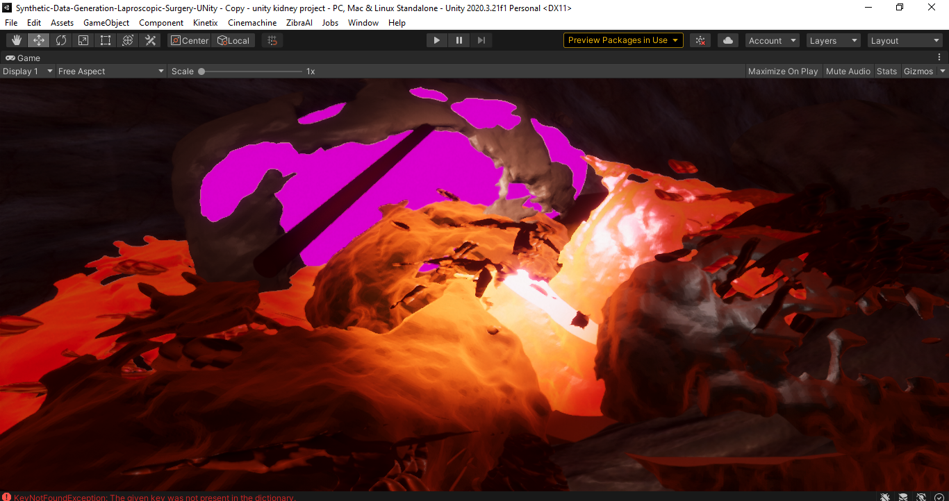

Kidney Simulation Setup
Semantic segmentation labels and bounding box annotations
Importance of adjusting lighting and camera angles

Slide 11
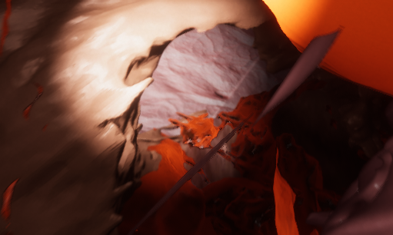
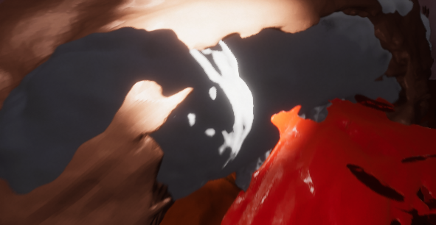


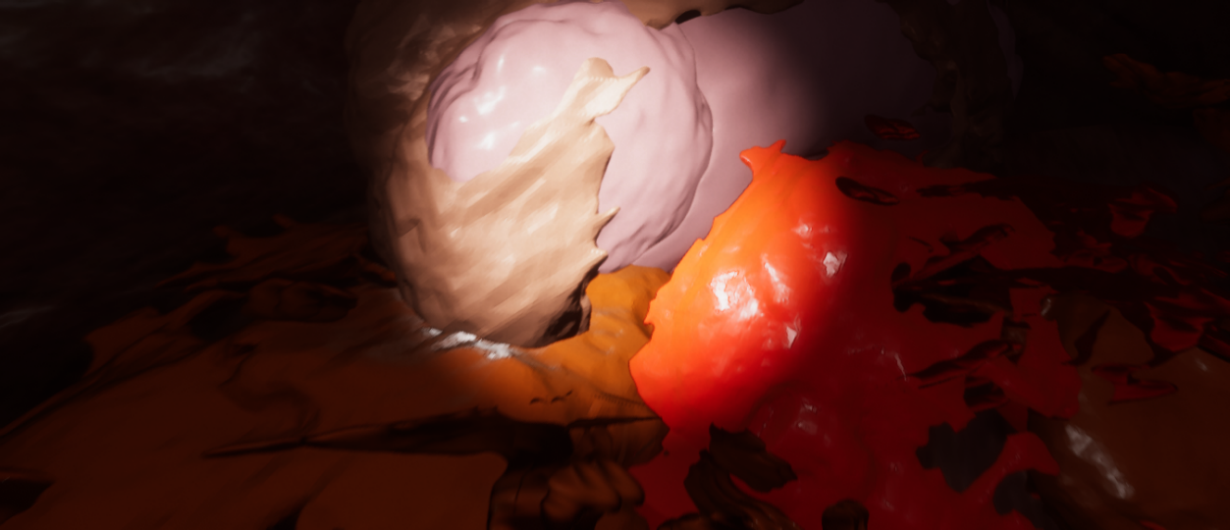
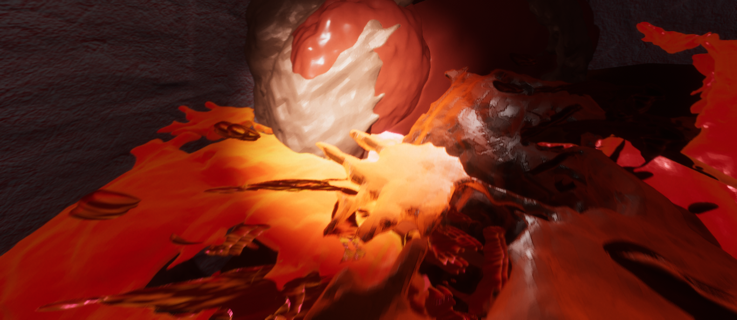
Different sets of data

Slide 12
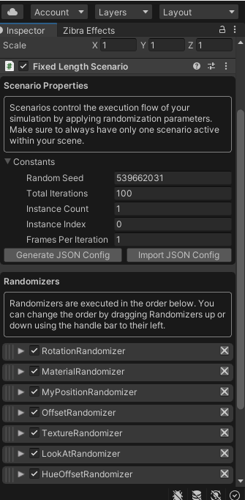
Fixed Length Scenario Configuration
Unity Perception configuration for a fixed length scenario
Explanation of random seed, total iterations, and randomizers

Slide 13
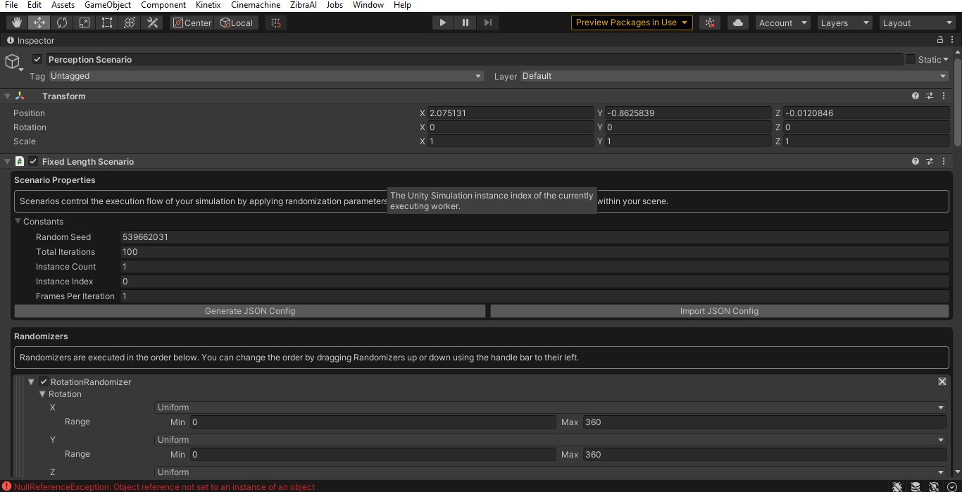
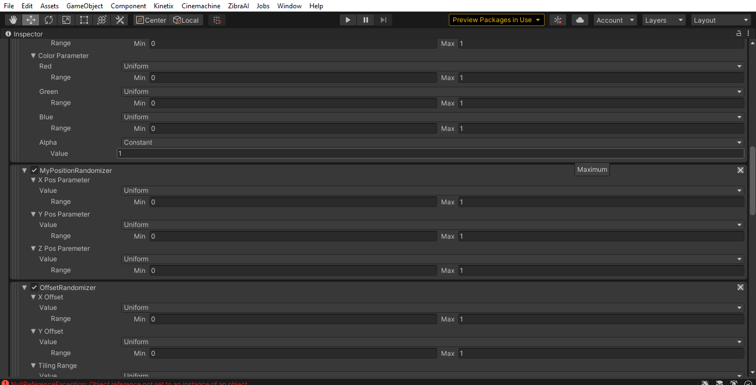
Randomizer Parameters
configuration of various randomizers in Unity Perception
Role of MyPositionRandomizer and OffsetRandomizer in data diversity

Slide 14
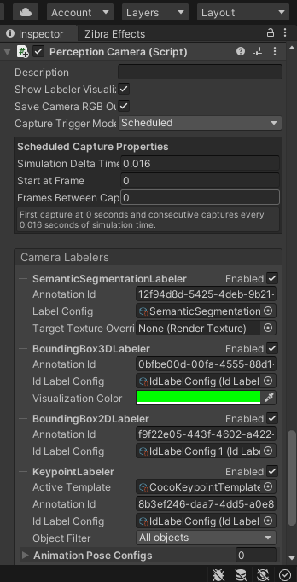
Perception Camera Configuration
Perception Camera setup with semantic segmentation, bounding box 2D/3D, and keypoint labelers
Importance of capture frequency and frame settings

Slide 15
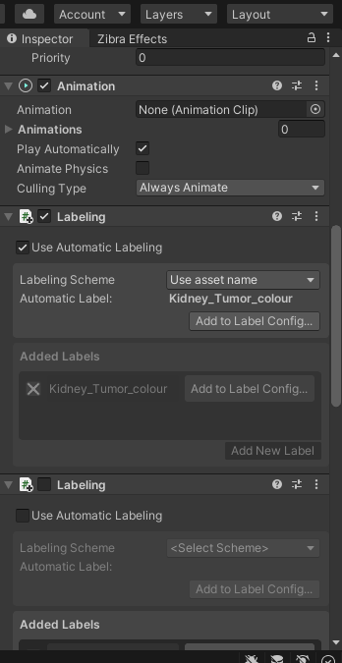
Automatic Labeling Setup
Automatic labeling setup using asset names
Need for consistent and accurate data labeling

Slide 16
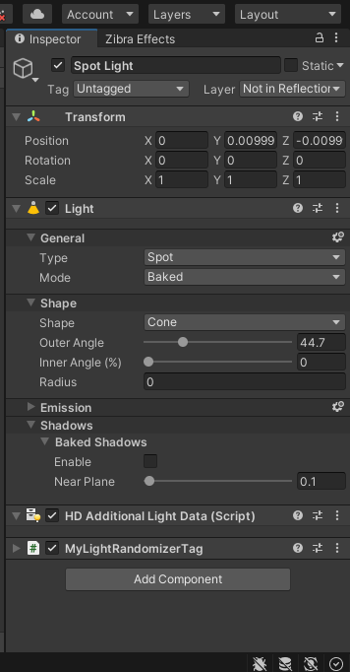
Spot Light Configuration
Configuration of spot light in Unity
Impact of light angles, intensities, and shadow settings on annotation quality

Slide 17
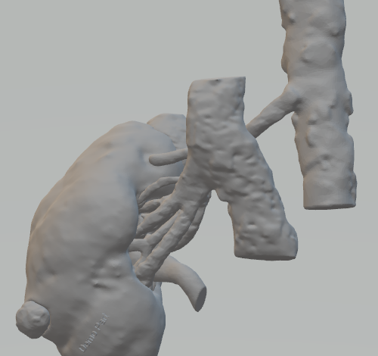

High-Resolution Kidney Model
High-resolution kidney model used in simulation
Importance of anatomical accuracy and realistic representation

Slide 18
Synthetic Data Generation
Unity Perception Configuration
Data Types and Examples
Quality Assurance Process

Slide 19
Synthetic Data Generation
Data Labeling: Describe how you labeled and annotated data for aspects such as kidney position and orientation.
Data Diversity: Discuss how you ensured diversity in the data with varying scenarios, lighting, and camera angles.

Slide 20

Data Generation Process
Unity Perception: Explain how Unity Perception was used to generate synthetic data.
Data Types: List the types of data generated, including 2D and 3D labels, semantic labeling, and metadata.

Slide 21
Applications and Future Perspectives
Educational Tools
Research and Development
Pre-surgical Planning
Validation of Medical Devices
Augmented Reality (AR) and Virtual Reality (VR) Applications

Slide 22
Future Work
Expansion to Other Anatomical Structures
Incorporation of Surgical Tools and Instruments
Multi-modal Data Integration
Real-time Data Generation
User Feedback and Iterative Improvement

Slide 23
Results and Evaluation
Expert Feedback (Inferred from Literature)
Challenges Faced
Solutions Implemented

Slide 24
Conclusion
Key Findings and Implications
Significant Contributions
Future Research Directions

Slide 25
References
https://github.com/Unity-Technologies/com.unity.perception/blob/main/README.md
https://learn.unity.com/
https://assetstore.unity.com/packages/templates/tutorials/cinematic-studio-sample-192852
https://unity.com/visual-effect-graph
https://docs.unity3d.com/Packages/com.unity.perception@1.0/manual/index.html

Slide 26

Thank You

